Slide 1
TREES
Notes:
https://www.w3resource.com/c-programming-exercises/linked_list/index.php
http://www.ggu.ac.in/download/IT/Inf%20Tech%20Pankaj%20Chandra%20B%20Tech%20%20IV%20Data%20Structure%20-%20Model%20Answer.pdf

Slide 2

Nature View of a Tree
leaves
branches
root

Slide 3

Computer Scientist’s View
root
leaves
branches
nodes

Slide 4
What is tree?
A tree is a collection of nodes. The collection can be empty; otherwise, a tree consists of a distinguished node r, called the root, and zero or more non-empty (sub) trees T₁, T₂, …, T_{k} each of whose roots are connected by a directed edge from r.
A tree is a collection of N nodes, one of which is the root and N-1 edges.
A tree is a finite nonempty set of elements.
Unlike Arrays, Linked Lists, Stack and queues, which are linear data structures, trees are hierarchical data structures.
Consists of nodes with a parent-child relation.
Applications:
Organization charts
File systems
Computers”R”Us
Sales
Manufacturing
R&D
US
International
Laptops
Desktops
Europe
Asia
Canada

Slide 5
Tree Terminology
Parent & Child: The root of each subtree is said to be a child of r and r is said to be the parent of each subtree root.
Root: node without parent (A)
Siblings: nodes share the same parent (B,C,D)
Internal node: node with at least one child (A, B, C, F)
External node (leaf ): node without children (E, I, J, K, G, H, D)
Ancestors of a node: parent, grandparent, grand-grandparent, etc.
Descendant of a node: child, grandchild, grand-grandchild, etc.
Degree of a node: the number of its children
Degree of a tree: the maximum number of its node.
Subtree: tree consisting of a node and its descendants
A
subtree
B
C
D
E
F
G
H
I
J
K

Slide 6
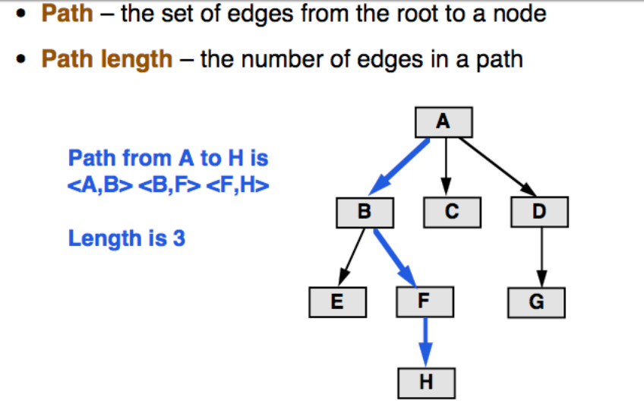
A path from node n₁ to n_{k} is defined as a sequence of nodes n₁, n₂, …, n_{k} such that n_{i} is the parent of n_{i+1} for 1<= i <= k.
The length of this path is the number of edges on the path namely k-1.
The length of the path from a node to itself is 0.
There is exactly one path from the root to each node.

Slide 7
Depth (of node): The length of the unique path from the root to a node.
Depth (of tree): The depth of a tree is equal to the depth of its deepest leaf.
Level (of node): Number of nodes on path from root to the node (including root and node)
Level of root is 1.
Height (of node): The length of the longest path from a node to a leaf.
All leaves have a height of 0
The height of the root is equal to the depth of the tree.

Slide 8
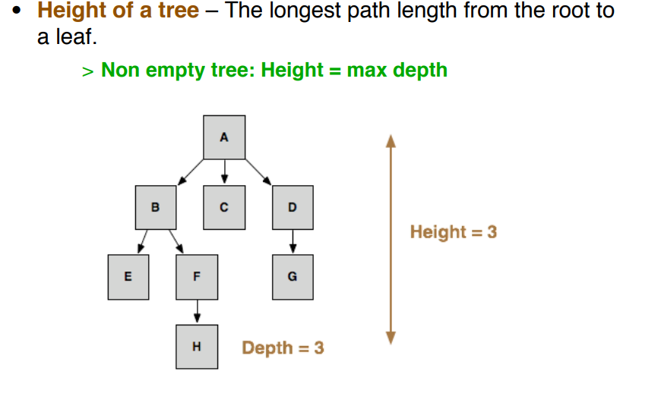

Slide 9
Different Types of trees
Binary Tree
Complete Binary Tree
Full Binary Tree
Extended Binary Tree
Threaded Binary Tree
Binary Search Tree
AVL Tree
B-Tree
Red-Black tree

Slide 10
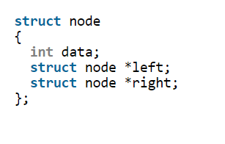
Binary Tree
A tree whose elements have at most 2 children is called a binary tree. Since each element in a binary tree can have only 2 children, we typically name them the left and right child.
A tree is represented by a pointer to the topmost node in tree. If the tree is empty, then value of root is NULL. A Tree node contains following parts. 1. Data 2. Pointer to left child 3. Pointer to right child
In C, we can represent a tree node using structures.

Slide 11
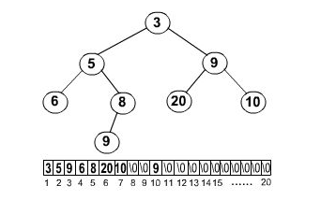
Array representation of binary tree
A single array can be used to represent a binary tree.
For these nodes are numbered / indexed according to a scheme giving 0 to root. Then all the nodes are numbered from left to right level by level from top to bottom. Empty nodes are also numbered. Then each node having an index i is put into the array as its ith element.
In the figure shown below the nodes of binary tree are numbered according to the given scheme.

Slide 12
Array representation of binary tree
The figure shows how a binary tree is represented as an array. The root 3 is the 0th element while its leftchild 5 is the 1 st element of the array. Node 6 does not have any child so its children ie 7 th & 8 th element of the array are shown as a Null value.
It is found that if n is the number or index of a node, then its left child occurs at (2n + 1)th position & right child at (2n + 2)th position of the array. If any node does not have any of its child, then null value is stored at the corresponding index of the array.

Slide 13
C function to implement binary tree using linked list

Slide 14
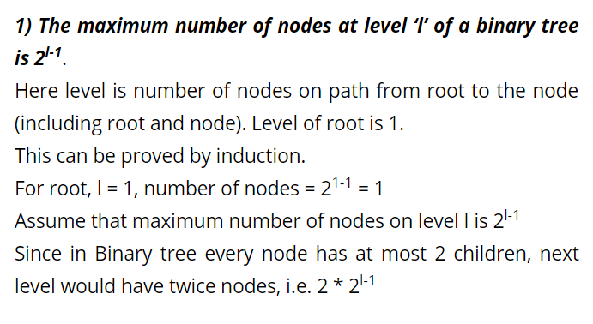
Properties of binary tree

Slide 15
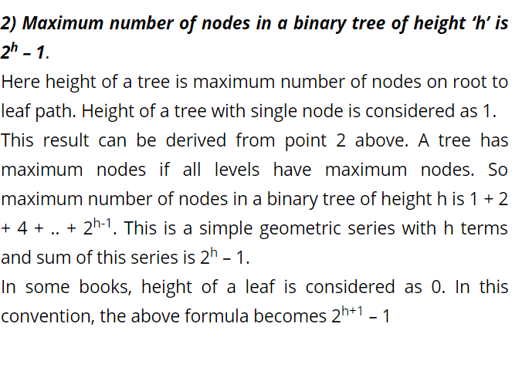

Slide 16
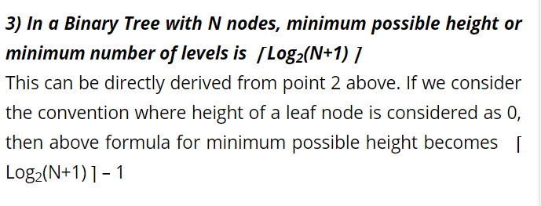

Slide 17
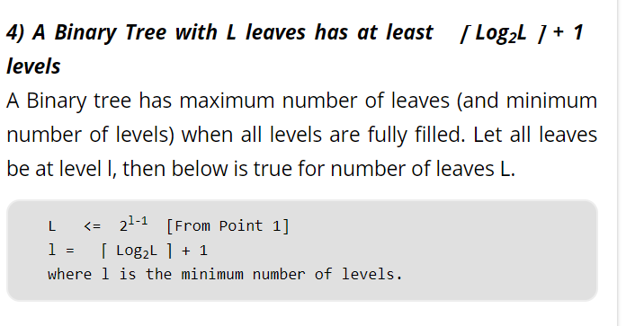
Notes:
Venn diagram of binary, full, complete

Slide 18
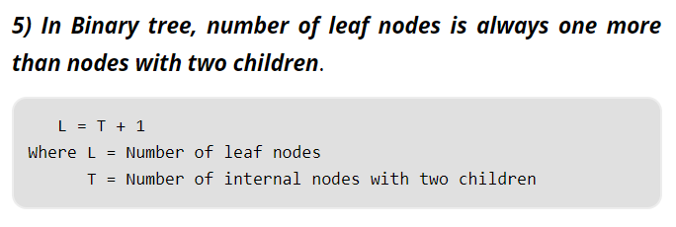

Slide 19
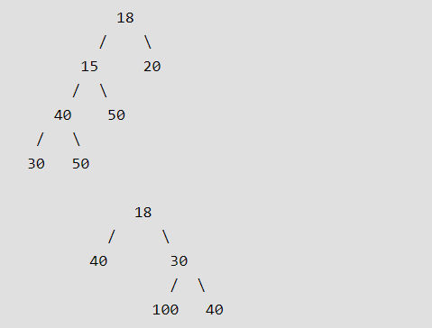
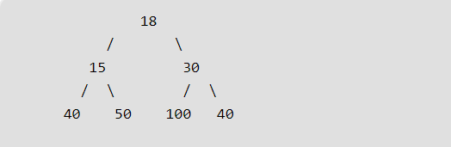
Types of Binary tree
Full Binary Tree
A Binary Tree is full if every node has 0 or 2 children. Following are examples of full binary tree. We can also say a full binary tree is a binary tree in which all nodes except leaves have two children.

Slide 20
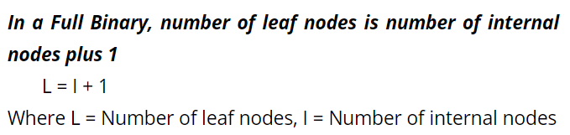
Types of Binary tree

Slide 21
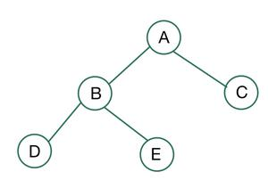
Properties of Full Binary Tree
Let, i be the number of internal nodes n be the total number of nodes l be number of leaves λ be number of levels
Then,
The number of leaves is (i + 1). The total number of nodes is (2i + 1). The number of internal nodes is (n – 1) / 2. The number of leaves is (n + 1) / 2. The total number of nodes is (2l – 1). The number of internal nodes is (l – 1). The number of leaves is at most (2^{λ-1} ).
Notes:
L=i+1
n=2i+1
i=(n-1)/2
L=((n-1)/2)+1 = (n+1)/2
2L-1=n
i=(n-1)/2 → 2i=n-1 → 2i=2L-1-1 → 2i=2L-2 → i=L-1

Slide 22
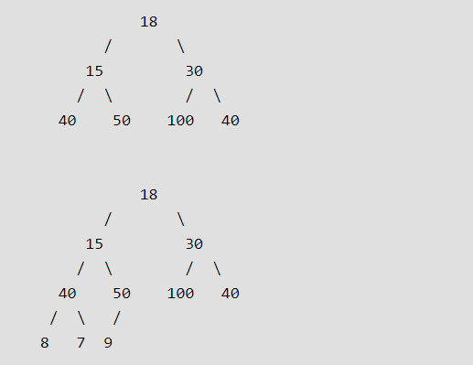
Types of Binary tree
Complete Binary Tree
A Binary Tree is complete Binary Tree if all levels are completely filled except possibly the last level and the last level has all keys as left as possible.

Slide 23
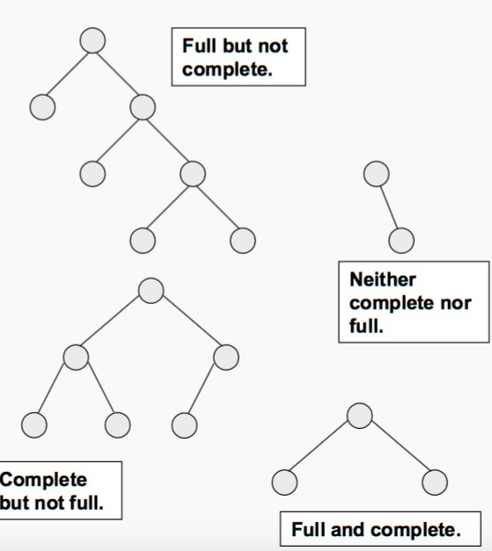
Complete and Full Binary Tree
https://www.geeksforgeeks.org/difference-between-full-and-complete-binary-tree/
A full binary tree is a binary tree in which all of the nodes have either 0 or 2 offspring. In other terms, a full binary tree is a binary tree in which all nodes, except the leaf nodes, have two offspring.
A binary tree is said to be a complete binary tree if all its levels, except possibly the last level, have the maximum number of possible nodes, and all the nodes in the last level appear as far left as possible.

Slide 24
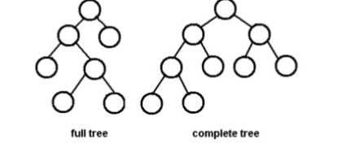
Question?

Slide 25
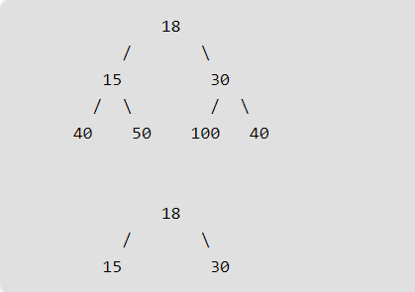
Types of Binary tree
Perfect Binary Tree
A Binary tree is Perfect Binary Tree in which all internal nodes have two children and all leaves are at same level.
A Perfect Binary Tree of height h (where height is number of nodes on path from root to leaf) has 2^{h} – 1 node. (Assumption: height of leaf is 1)

Slide 26
Types of Binary tree
Balanced Binary Tree
A binary tree is balanced if height of the tree is O(Log n) where n is number of nodes.
For Example, AVL tree maintain O(Log n) height by making sure that the difference between heights of left and right subtrees is 1.
Balanced Binary Search trees are performance wise good as they provide O(log n) time for search, insert and delete.

Slide 27
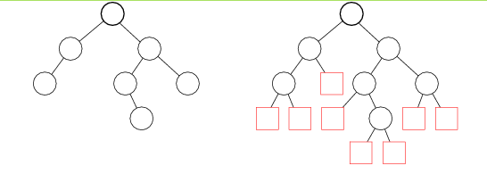
Types of Binary tree
Extended Binary Tree
An extended binary tree is a transformation of any binary tree into a full binary tree. This transformation consists of replacing every null subtree of the original tree with “special nodes.” The nodes from the original tree are then internal nodes, while the “special nodes” are external nodes.

Slide 28

Types of Binary tree
Degenerate (or Pathological) Tree
A Tree where every internal node has one child. Such trees are performance-wise same as linked list.

Slide 29
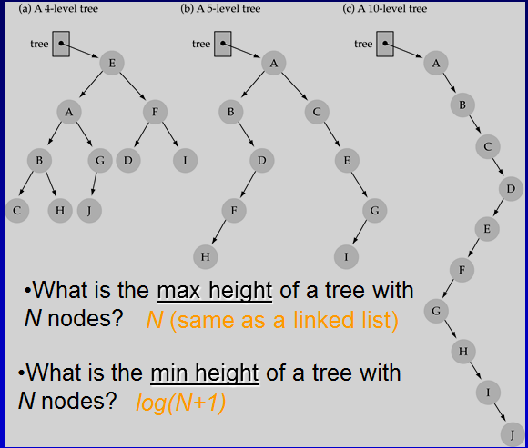
Question
Here root node starts from 1

Slide 30
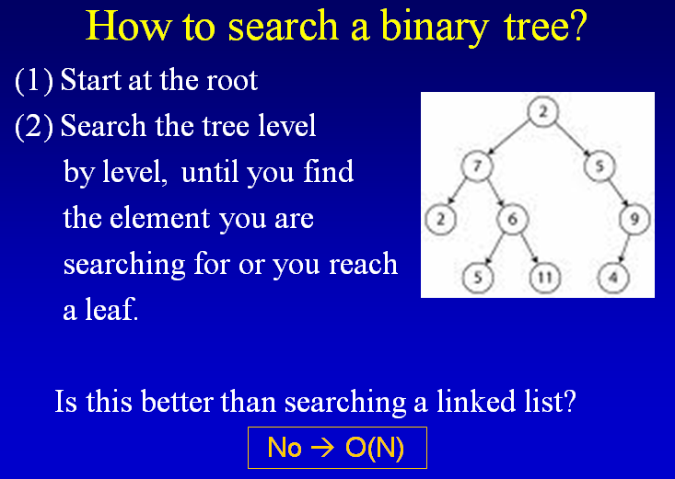
Searching in binary tree

Slide 31
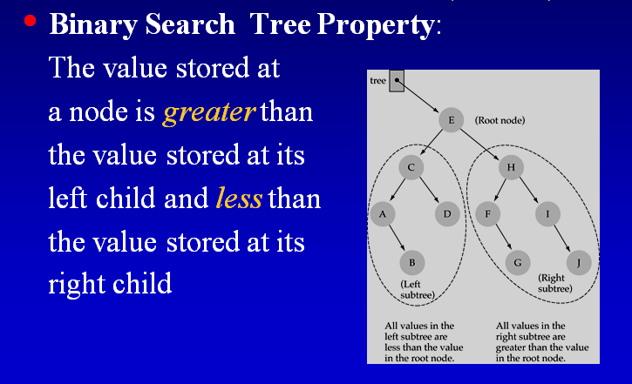
Binary search tree

Slide 32
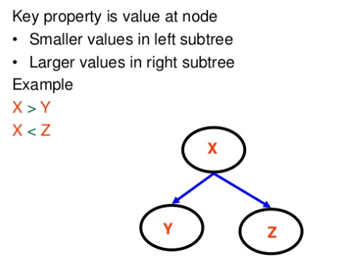
Binary search tree

Slide 33
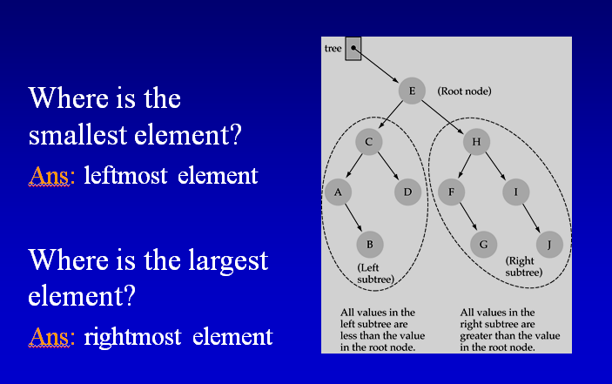

Slide 34
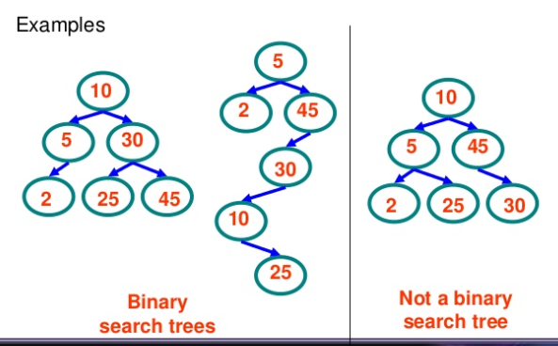
Examples of bst

Slide 35
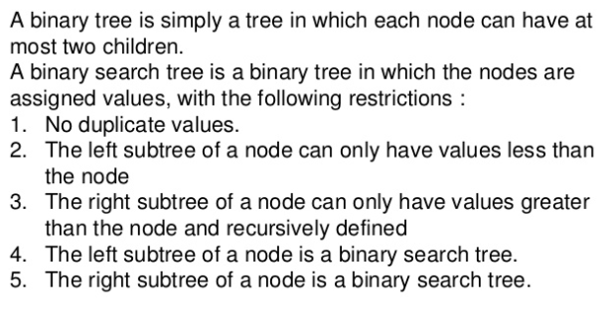
Difference between bt & bst

Slide 36
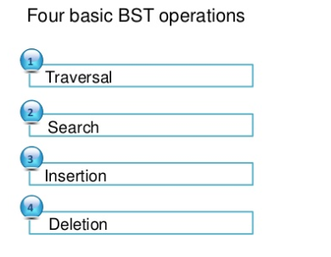
Bst operations

Slide 37
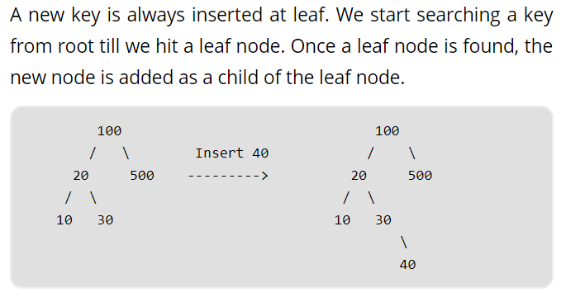
Bst insertion

Slide 38
C program for Insertion in bst

Slide 39
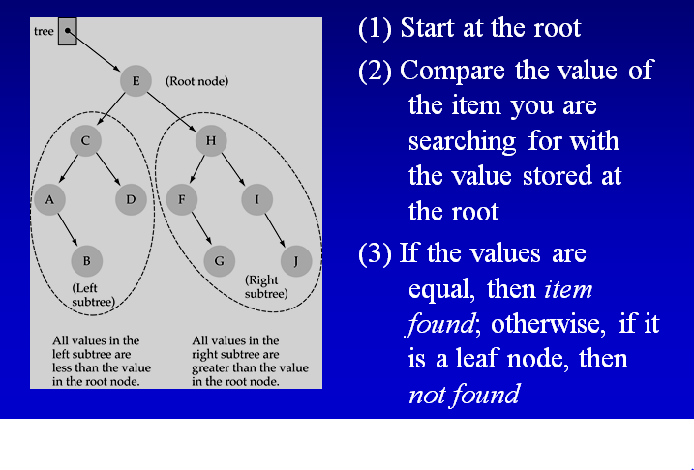
How to search in bst

Slide 40
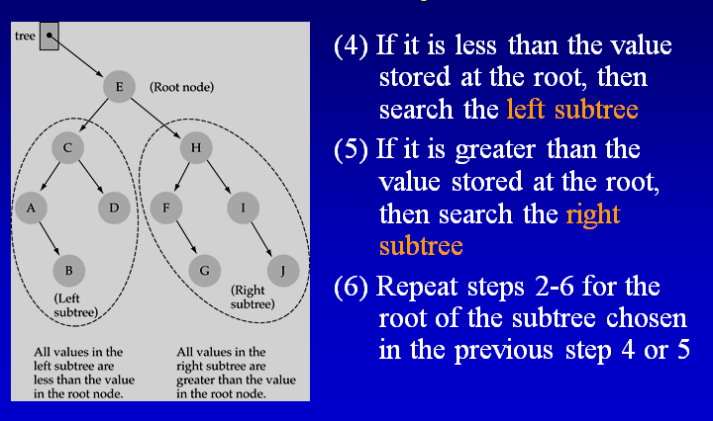
How to search in bst

Slide 41
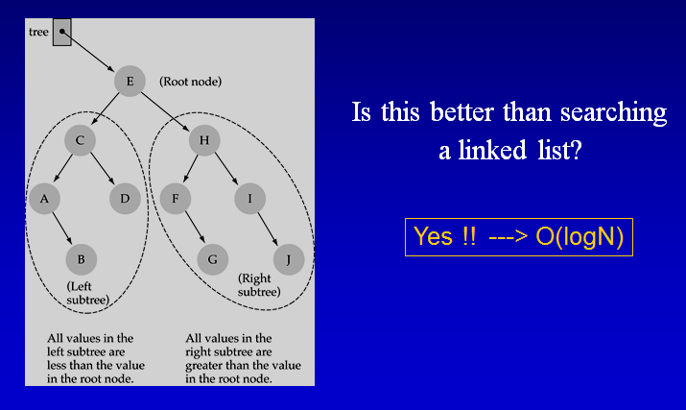
How to search in bst

Slide 42
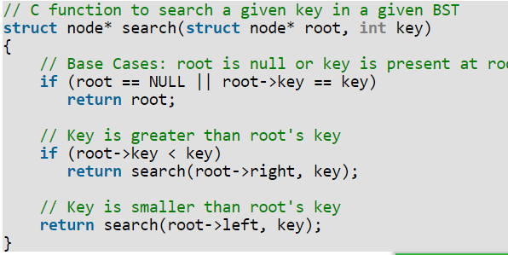
Function to search an element

Slide 43
BST traversal
Unlike linear data structures (Array, Linked List, Queues, Stacks, etc.) which have only one logical way to traverse them, trees can be traversed in different ways.
Following are the generally used ways for traversing trees.
1) Depth First Traversals:
(a) Inorder (Left, Root, Right)
(b) Preorder (Root, Left, Right)
(c) Postorder (Left, Right, Root)
2) Breadth First or Level Order Traversal

Slide 44
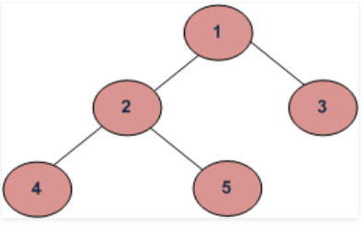
Depth First Traversals: (a) Inorder (Left, Root, Right) : 4 2 5 1 3 (b) Preorder (Root, Left, Right) : 1 2 4 5 3 (c) Postorder (Left, Right, Root) : 4 5 2 3 1
Breadth First or Level Order Traversal : 1 2 3 4 5

Slide 45
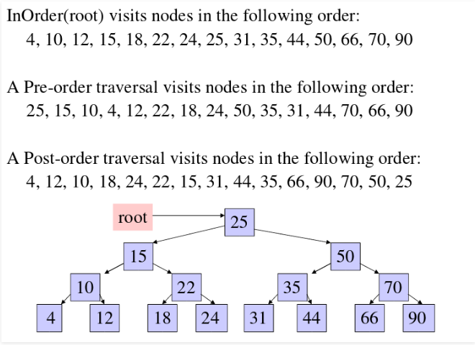
Example

Slide 46
Algorithm Inorder(tree)
Traverse the left subtree, i.e., call Inorder(left-subtree)
Visit the root.
Traverse the right subtree, i.e., call Inorder(right-subtree)
Uses of Inorder In case of binary search trees (BST), Inorder traversal gives nodes in increasing order. To get nodes of BST in non-increasing order, a variation of Inorder traversal where Inorder traversal is reversed, can be used.

Slide 47
Algorithm Preorder(tree)
Visit the root.
Traverse the left subtree, i.e., call Preorder(left-subtree)
Traverse the right subtree, i.e., call Preorder(right-subtree)
Uses of Preorder Preorder traversal is also used to get prefix expression on of an expression tree.

Slide 48
Algorithm Postorder(tree)
Traverse the left subtree, i.e., call Postorder(left-subtree)
Traverse the right subtree, i.e., call Postorder(right-subtree)
Visit the root.
Uses of Postorder
Postorder traversal is also useful to get the postfix expression of an expression tree.

Slide 49
C functions for tree traversal

Slide 50
Level order traversal

Slide 51
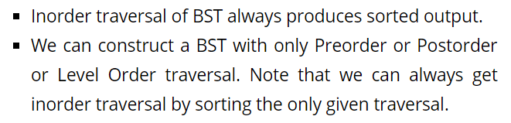
Some interesting facts

Slide 52
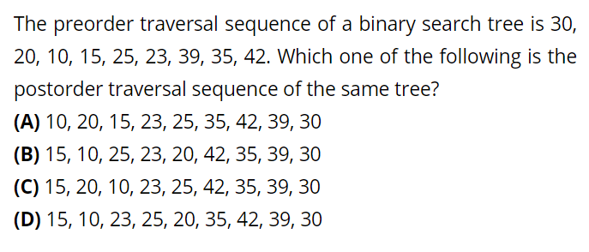
Question
Notes:
Ans is D

Slide 53
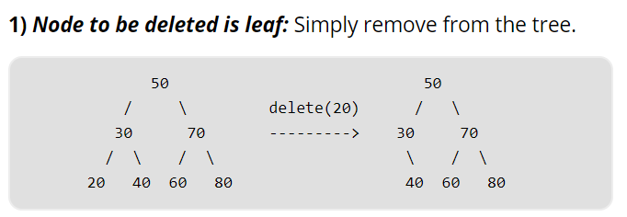
Deletion in BST
When we delete a node, there possibilities arise:

Slide 54
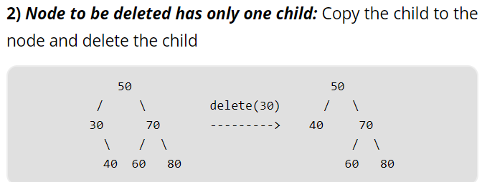

Slide 55
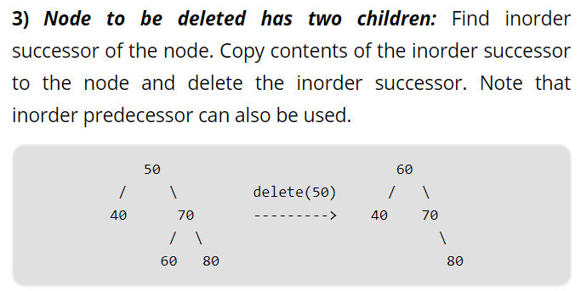

Slide 56
C program to delete a node from BST

Slide 57
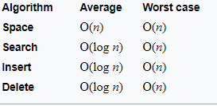
Time complexities of all operations

Slide 58
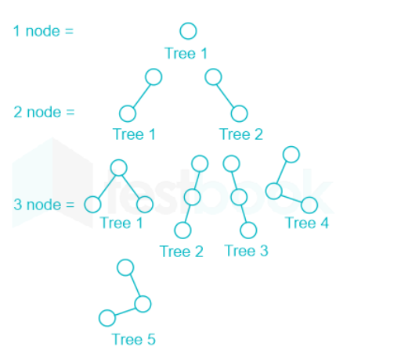
Number of binary trees with n nodes
2^n - n

Slide 59
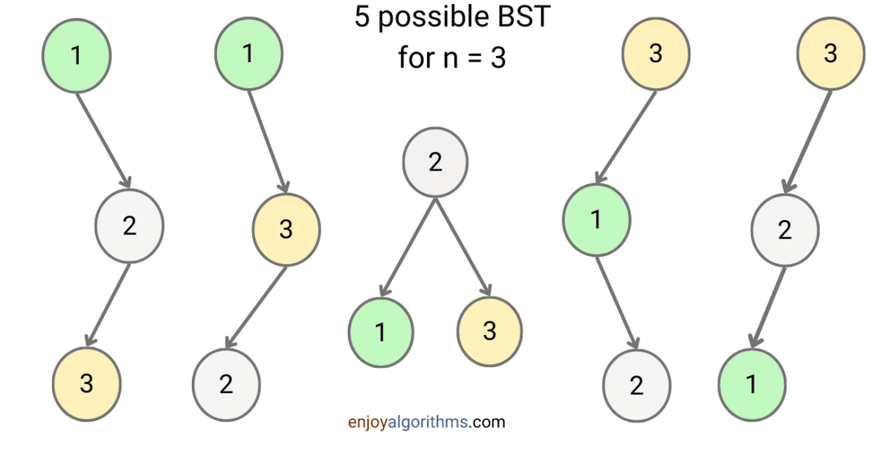
Total No. of BST with n nodes
https://www.enjoyalgorithms.com/blog/total-number-of-binary-search-trees-with-n-keys
(Proof asked in Amazon and Microsoft: given in above link)
In combinatorial mathematics, the Catalan numbers are a sequence of natural numbers that occur in various counting problems, often involving recursively defined objects.

Slide 60
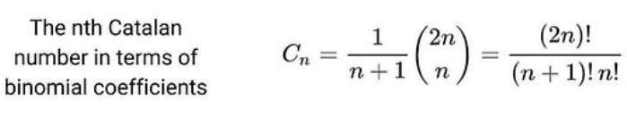

Slide 61
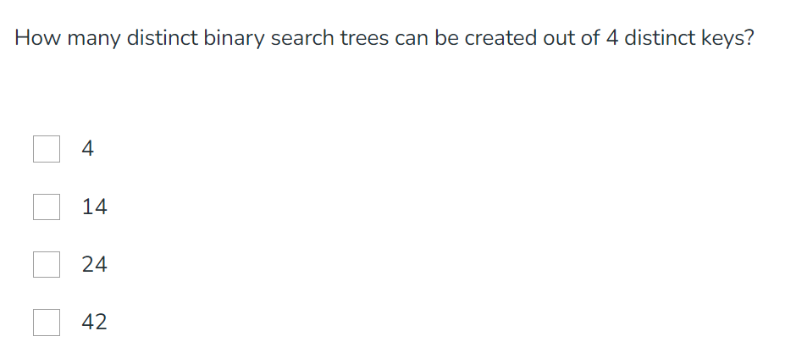
Question
Notes:
Ans 14

Slide 62
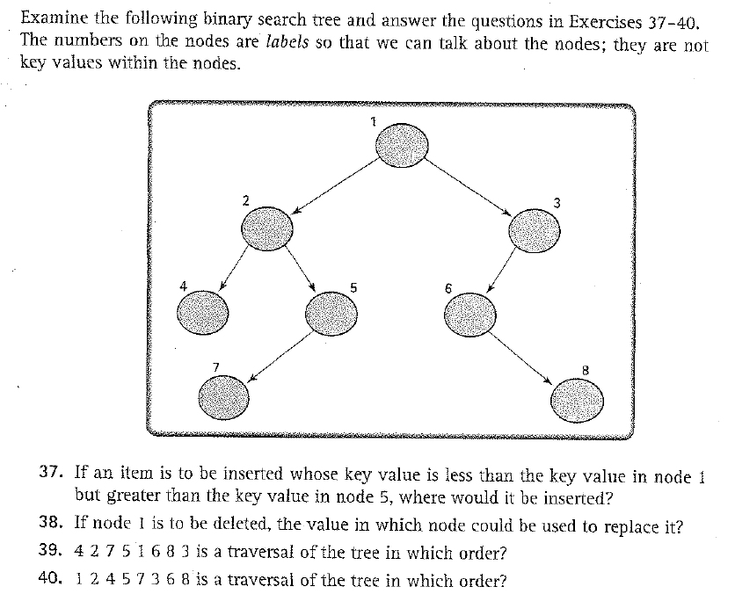
Practice questions
Notes:
37: right side of 5
38: 6 or 5
39: Inorder
40: Preorder

Slide 63
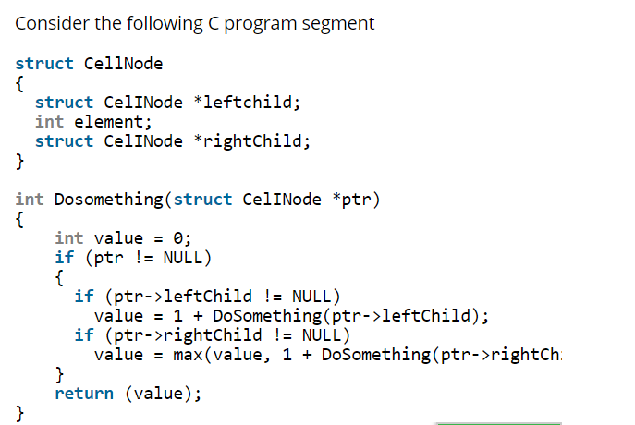
Question

Slide 64
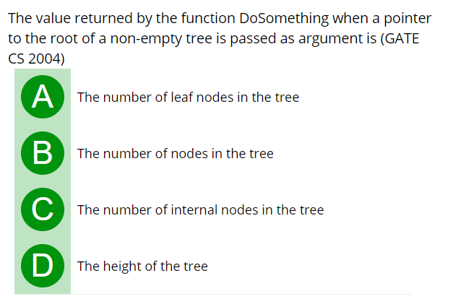
Question
Notes:
Ans D

Slide 65
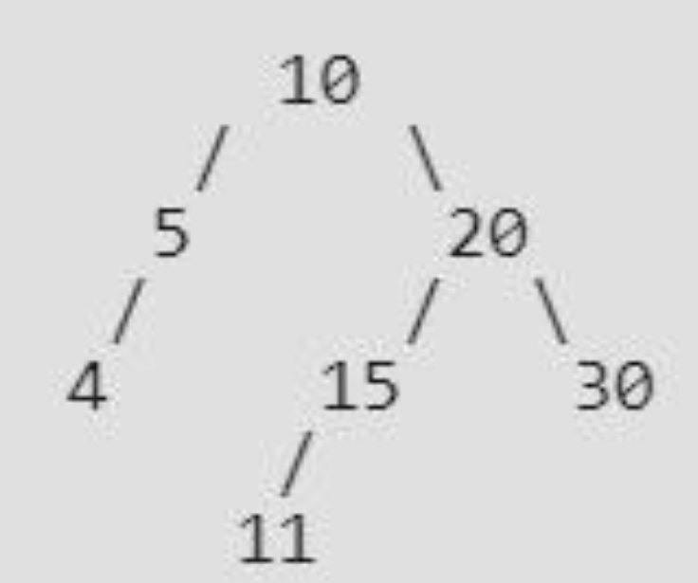
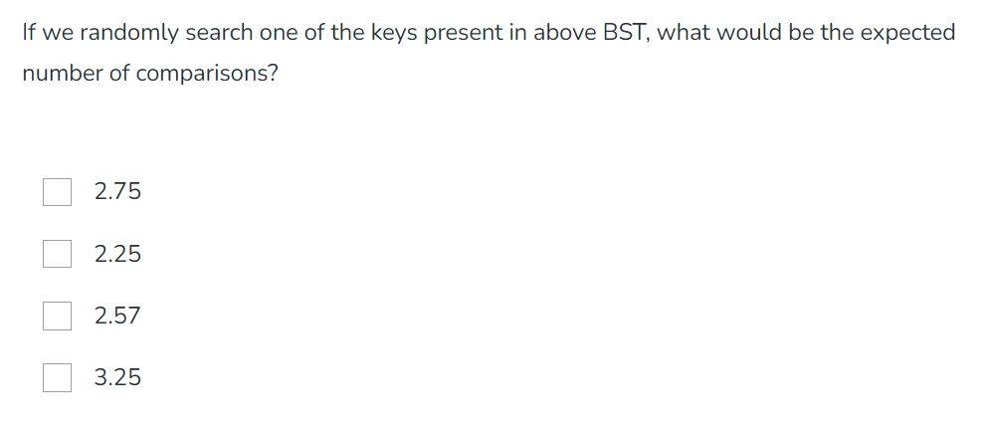
Question
Notes:
Ans 2.57

Slide 66
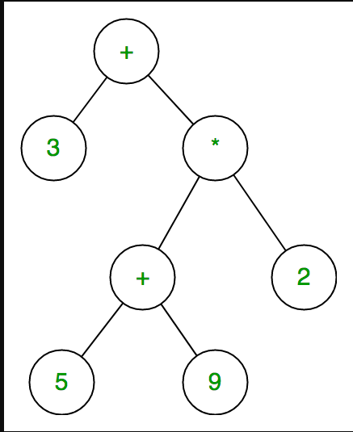
Expression tree
Expression tree is a binary tree in which each internal node corresponds to operator and each leaf node corresponds to operand so for example expression tree for 3 + ((5+9)*2) would be:

Slide 67
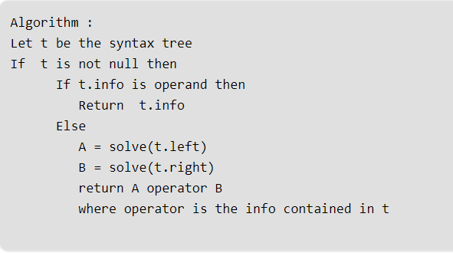
Evaluation of expression tree
Given a simple expression tree, consisting of basic binary operators i.e., + , – ,* and / and some integers, evaluate the expression tree.
As all the operators in the tree are binary hence each node will have either 0 or 2 children. As it can be inferred from the examples above , the integer values would appear at the leaf nodes , while the interior nodes represent the operators.
To evaluate the syntax tree , a recursive approach can be followed .

Slide 68


Slide 69


Slide 70
Practice MCQ Questions
https://www.geeksforgeeks.org/data-structure-gq/top-mcqs-on-binary-search-tree-bst-data-structure-with-answers/

Slide 71
Top 50 Tree Coding problems asked in interview
https://www.geeksforgeeks.org/top-50-tree-coding-problems-for-interviews/

Slide 72
Lab Exercise
Create a binary tree using an array and linked List.
Construct a Binary Search Tree using Linked List and perform below operations:
Implement search in BST
Implement inorder, preorder, postorder traversal in BST
Implement deletion in BST

